Slide 1
Design of Critically Coupled Microring Resonators
Mustafa Hammood
2020

Slide 2






Microring Resonators
$$t_{1}$$
$$κ_{1}$$
$$Radius$$
Key devices in integrated photonics
Applications:
Wavelength-division multiplexing filters
Modulators
Non-linear effects
Calibration structures
$$κ_{1}$$
$$Gap$$
$$t_{1}$$

Slide 3





All-pass
$$Radius$$
All-pass ring with no drop port
Roundtrip length: $L_{rt}=2πr$
Through port response $\frac{E_{thru}}{E_{in}}=\frac{−\sqrt{A}+te^{−jφ_{rt}}}{−\sqrt{A}t^{∗}+te^{−jφ_{rt}}}$
$t$ is the forward coupling coefficient
$φ_{rt}=βL_{rt}$
$β_{(λ)}=\frac{2πn_{eff\left(λ\right)}}{λ}$
$A=e^{−αL_{rt}}$
$α$ are the losses in the system, including coupling, propagation, and bending.
$$κ$$
$$Gap$$
$$E_{in}$$
$$t$$
$$E_{thru}$$

Slide 4

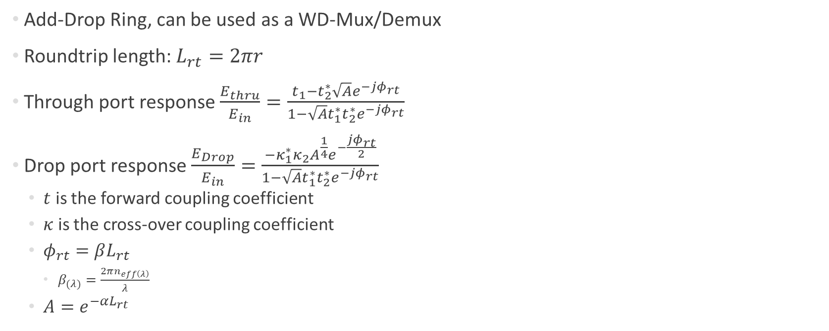


Add-drop
$$t_{2}$$
$$E_{drop}$$
$$κ_{2}$$
$$Radius$$
Add-Drop Ring, can be used as a WD-Mux/Demux
Roundtrip length: $L_{rt}=2πr$
Through port response $\frac{E_{thru}}{E_{in}}=\frac{t_{1}−t_{2}^{∗}\sqrt{A}e^{−jφ_{rt}}}{1−\sqrt{A}t_{1}^{∗}t_{2}^{∗}e^{−jφ_{rt}}}$
Drop port response $\frac{E_{Drop}}{E_{in}}=\frac{−κ_{1}^{∗}κ_{2}A^{\frac{1}{4}}e^{−\frac{jφ_{rt}}{2}}}{1−\sqrt{A}t_{1}^{∗}t_{2}^{∗}e^{−jφ_{rt}}}$
$t$ is the forward coupling coefficient
$κ$ is the cross-over coupling coefficient
$φ_{rt}=βL_{rt}$
$β_{(λ)}=\frac{2πn_{eff\left(λ\right)}}{λ}$
$A=e^{−αL_{rt}}$
$$κ_{1}$$
$$Gap$$
$$E_{in}$$
$$t_{1}$$
$$E_{thru}$$

Slide 5
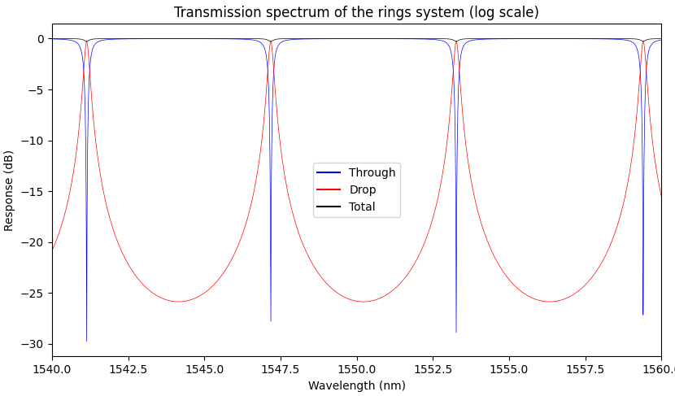
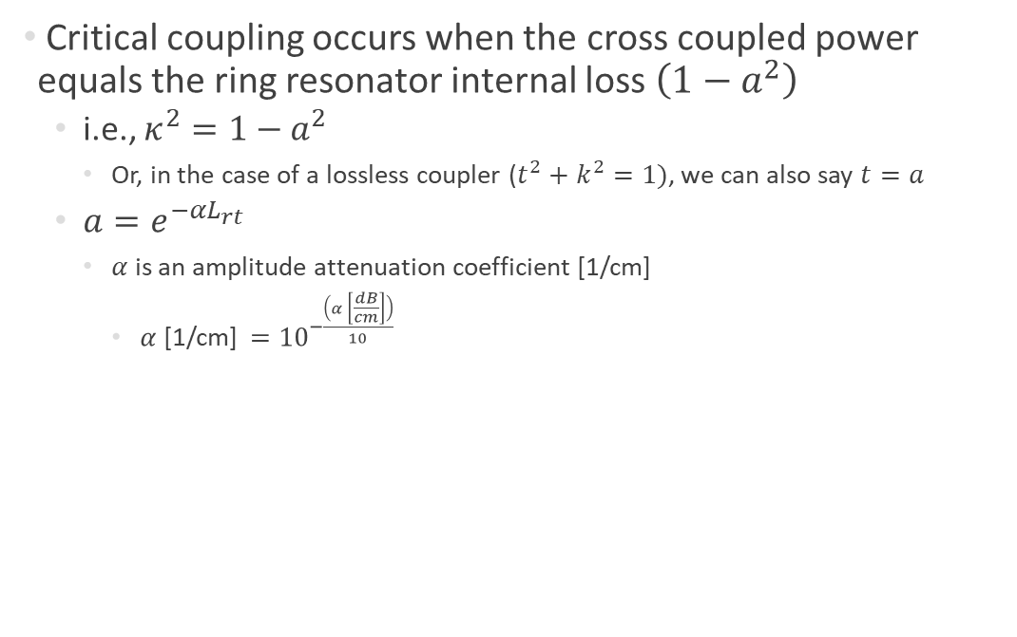
Critical coupling
$$t_{2}$$
$$E_{drop}$$
$$κ_{2}$$
$$Radius$$
Critical coupling occurs when the cross coupled power equals the ring resonator internal loss $\left(1−a^{2}\right)$
i.e., $κ^{2}=1−a^{2}$
Or, in the case of a lossless coupler ($t^{2}+k^{2}=1)$, we can also say $t=a$
$a=e^{−αL_{rt}}$
$α$ is an amplitude attenuation coefficient [1/cm]
$α$ [1/cm] $={10}^{−\frac{\left(α \left[\frac{dB}{cm}\right]\right)}{10}}$
$$κ_{1}$$
$$Gap$$
$$E_{in}$$
$$t_{1}$$
$$E_{thru}$$

